Slide 1
Shakespeare Notes

Slide 2
Part One
Character Types in Shakespeare’s Plays

Slide 3
Basic Character Definitions
Dynamic Character: One who undergoes significant inner change or growth in personality and/or attitude during the course of a play; often referred to as a round or complex character.
Static or stock character: One who does not undergo significant change or growth during the course of a play; often referred to as a flat, or two-dimensional; stereotypical and often predictable; they usually do one of the following:
- Provide comic relief
- Deliver vital information or give assistance to other characters.
- Serve as a menacing character that hinders or helps the hero to change in the course of a play.

Slide 4
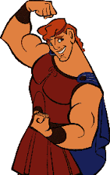
Basic Hero
He’s a courageous figure
He’s self-motivated
He’s very active, usually athletic
He’s usually considered to be handsome

Slide 5
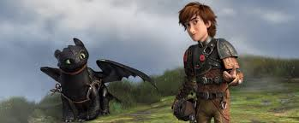
Tragic Hero/Character
Displays a tragic flaw- an error in judgment or defect in character- that leads to downfall
Neither all good nor all evil
Suffers and learns from mistakes
Usually must make a serious decision based on what they have learned

Slide 6
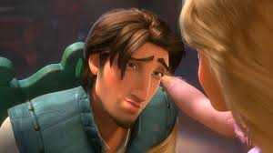
Romantic Hero/Character
Changes his mind easily about who his love interest is
Tends to be melancholy and sentimental
Generally handsome
There is usually something disagreeable about him (his friends and family have a complaint about him)
Often there is something mysterious and/or adventurous about him

Slide 7
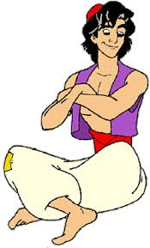
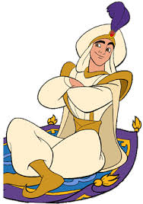
Comedic Hero/Character
Tends to be an underdog (from humble or disadvantaged backgrounds)
Has charm and with that wins the audience’s and often other character’s approvals
Often is a rogue or a scamp (a playfully mischievous person)
Has to prove that he has “real worth” through the course of the story line

Slide 8
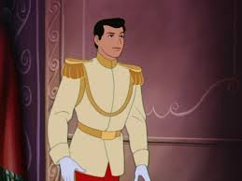
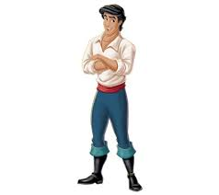
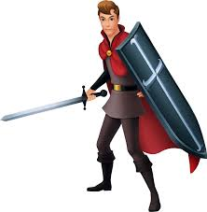
Historic Hero/Character
Character is part of monarchy/government
Viewed as powerful
Often are glorified because of stance/attitude concerning allies and/or enemies
Often there is a side or main story of a war/conflict between the city/country in the play and another city/country in the play.

Slide 9
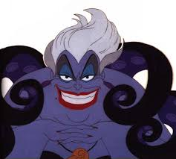
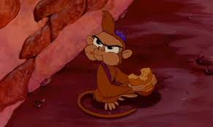
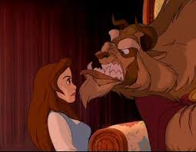
What about the “BAD GUY”?
Malign Influence: A character who causes trouble out of hatred, jealousy or temper.
Imp of Mischief: A character who misleads and deceives people, makes fun of them, but is not actively malign.
Mistreated Villain: A character who does wicked things, but only because he/she has ben driven to them by the way he/she has been treated.

Slide 10
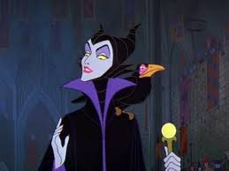
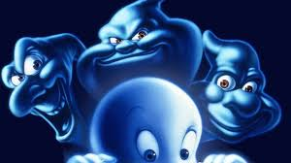
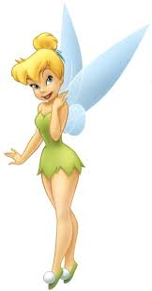
Supernatural Characters
Witches:
- make predictions for other characters
- “trap” characters with magic and trickery
Ghosts:
- causes fear and apprehension in audience for the actors’ situations in the play
- give the audience a connection with the characters’ possible after life
Fairies and Spirits:
- add a feeling of chaos to the play
- serve a childlike presence
- are usually good, but can have a “devilish” side.

Slide 11
Characters in Story Lines
Royalty: usually related by family or loyalty ties
People of the court/community: minor characters that are a part of the royal community
Love interest: the one the hero “lives” for
Servants: those who are friends of the hero
Commoners: non royal folks in the community
Merchants, doctors, solicitors: people in the community who have professions that aid in the story line
*these characters can be dynamic or static according to their rold and purpose in the story line.

Slide 12
Part Two
Types of Shakespeare Plays

Slide 13
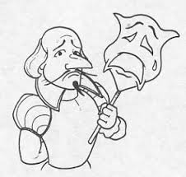
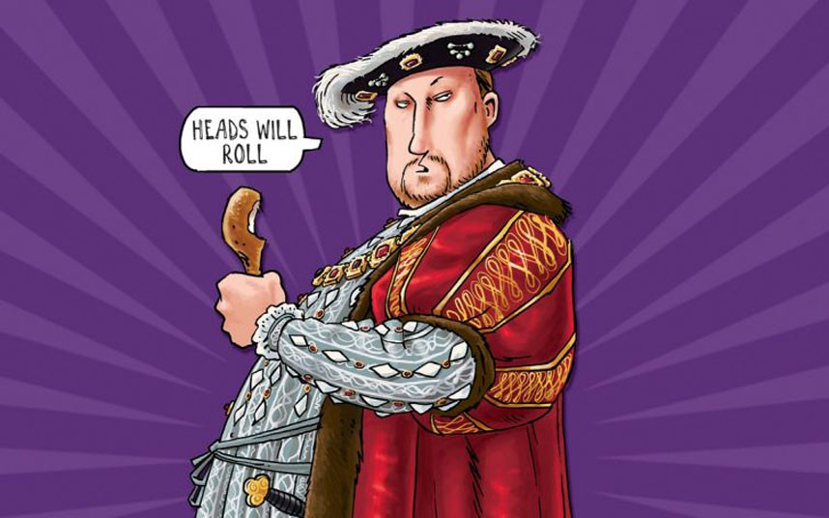
What did Shakespeare write?
Comedies: “happy ending”
Tragedies: end with death of main character(s)
Histories: focus on events in or similar to those in history

Slide 14
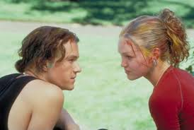
What makes a comedy?
A struggle of young lovers to overcome problems, often a result of the interference of their elders or others
Element of separation and reunification
Mistaken identities, often involving disguise
A clever servant
Family tensions that are usually resolved in the end
Complex, interwoven plot lines
Frequent use of puns, play on words, and other styles of comedy
Pastoral events: making fun of how courtly people live

Slide 15
Types of Comedies
Farce: hilarious improbability; wild coincidences and complications; absurd characters; comic deceptions and disguises
Romantic: sympathetic and well-matched lovers are united or reconciled; lovers are usually young; lovers often dept apart by complicating circumstances; fairy-tale ending
Satirical: include con-artists, criminals, tricksters, hypocrites, gullible dupes, goofs; the central character is usually foolish, cynical or morally corrupt; often referred to a “black comedy” (we laugh at mortifying or grotesque events)

Slide 16
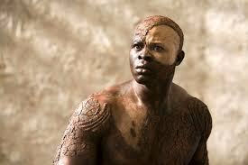
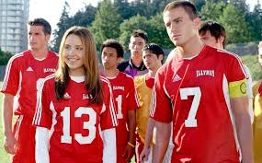
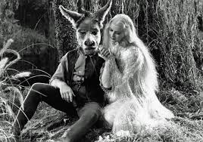
Shakespeare’s Comedies
The Merchant of Venice
Twelfth Night
All’s Well That Ends Well
The Tempest
Taming of the Shrew
The Winter’s Tale
As you Like It
The Comedy of Errors
Love’s Labours Lost
A Midsummer Night’s Dream
The Two Gentlemen of Verona
The Merry Wives of Windsor
Measure for Measure
Much Ado About Nothing
The Two Nobel Kingsmen

Slide 17
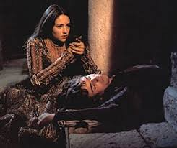
What makes a tragedy?
Often have comedic moments, but tends to have more serious and dramatic plots
Characters becomes isolated or there is a social breakdown
Ends in death
Events seem inevitable or inescapable
The central figure is noble with a character flaw which leads them to eventual downfall

Slide 18
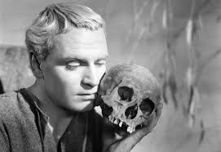
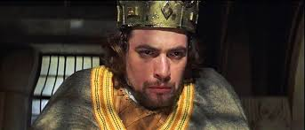
Shakespearean Tragedies
Macbeth
Hamlet
Romeo and Juliet
Titus Andronicus
Julius Caesar (also a history)
Troilus and Cressida
Othello
Coriolanus (also a history)
King Lear
Antony and Cleopatra (also a history)
Cymbeline (this is debated as a comedy)

Slide 19
What makes a history play?
Focus on England’s monarchs
Play on Elizabethan propaganda showing dangers of civil war and glorifying the queen’s ancestors
Royalty are depicted as powerful
It is believed that the depiction of the royalty was inaccurate

Slide 20
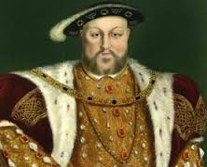
Shakespeare’s History Plays
King John
Richard II
King Henry IV (part 1 and 2)
King Henry V
King Henry VI (parts 1, 2, and 3)
Richard III
King Henry VIII
Coriolanus (also a tragedy)
Julius Caesar (also a tragedy)
Anthony and Cleopatra (also a tragedy)

Slide 21
Part Three
Situations, Themes, and content in Shakespeare’s plays

Slide 22
Common situational archetypes in Shakespeare’s plays
Star-crossed lovers
Elite ceremonies and celebrations
Hero’s fall from and/or rise to identify value, class, or title
Division in classes causing conflict
Mistaken identities that cause conflict/confusion
Separation and reunification of families/characters
Journey or quest to fulfill a destiny

Slide 23
Common themes in Shakespeare’s plays
Conflict: an opposition of action, feeling or effect
- man vs. man
- man vs. society
- man vs. nature
- man vs. self
Appearance and Reality: disguises or taking on another personality
- inner-self
- outer-self
Order and Disorder: a feeling of disconnection, chaos, or confusion
Change and/or Growth: happens as a result of plot events
- physical
- emotional/psychological
- social

Slide 24
What do we study Shakespeare?
To learn and understand:
- the stories (plot lines and twists)
- the characters (analysis of thoughts, words, actions)
- the language (devices and effects of usage)
- the themes (purposes and lessons)
- the dramatic effect (presentation of stories)

Slide 25
The End

