Slide 1
THE CRUCIBLE
Arthur miller

Slide 2
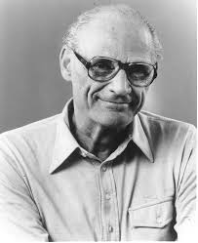
The Author
Arthur Miller
October 17, 1915 – February 10, 2005
January 22, 1953- Martin Beck Theater on Broadway (37 years old)
Too stylized and cold
Reviews were largely hostile
The New York Times noted "a powerful play [in a] driving performance.”
One year later-became a success. (Tony Award for Best Play)

Slide 3
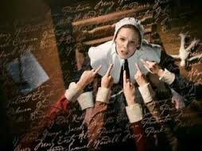
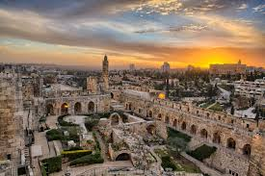
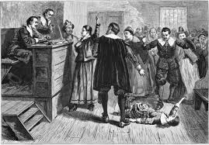
Where was the play based?
Salem, Massachusetts 1692.

Slide 4
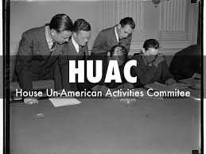
HUAC
House Un-American Activities Committee
Investigative committee of the United States House of Representatives.
1938- Originally created to uncover citizens with Nazi ties within the United States.
Better known for uncovering individuals and organizations with ties to Communism.
Arthur Miller told “no names.”
1957 Charged with “Contempt of Congress”
Overturned- misled by Chairman.

Slide 5
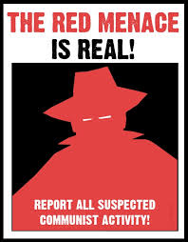
“Red Scare”
A Red Scare is the promotion of fear of a potential rise of communism or radical leftism, used by anti-leftist proponents. The Second Red Scare was focused on national and foreign communists influencing society, infiltrating the federal government, or both.”
“McCarthyism" after its most famous supporter, Senator Joseph McCarthy.
“McCarthyism is the practice of making accusations of disloyalty, subversion, or treason without proper regard for evidence.” (Unfair)

Slide 6
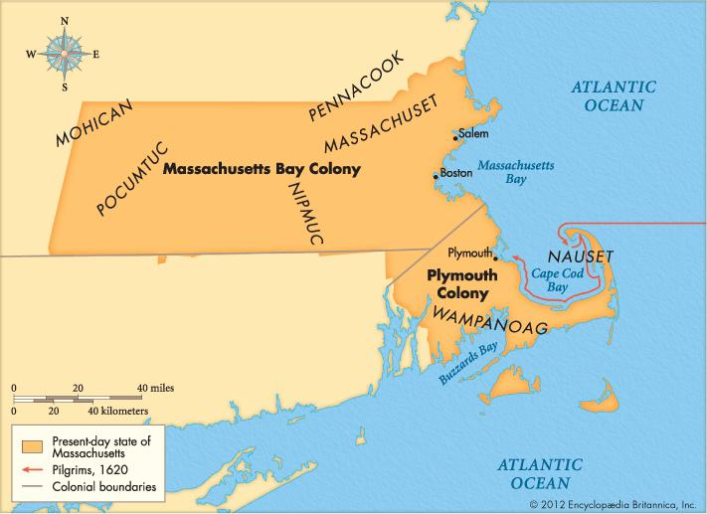
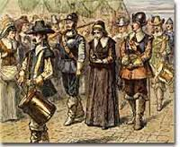
Massachusetts Bay Colony
Owners of the Massachusetts Bay Company
Winter of 1691-1692
Rye

